Slide 1

Custom Power Solutions from

Slide 2








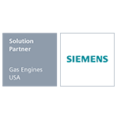

How It Works
By combining products from multiple leading manufacturers, and leveraging the expertise of our in-house application engineers, Kraft Power finds a one-vendor solution to even the most complex power needs.
Let’s walk through one example.

Slide 3
Initial Consultation
Working closely with the customer and our in-house engineers, Kraft Power’s knowledgeable sales team defines the scope of each project and develops a design plan to meet their specific power requirements.
A manufacturer of rock crushing equipment came to Kraft Power because they needed a power source for all of their hydraulics. In addition to a PTO, rock crusher applications require several additional hydraulic pumps.

Slide 4
Solution Development and Quoting
FPT Diesel Engine
+ Transfluid PTO and Pump Drive
Once the required products are identified, our in-house engineers use 3D design software to ensure proper fitment with the customer’s specific needs. Working with local fabricators, a budgetary price is established.
+
Murphy Control Panel
+
Kraft Power Custom Enclosure
+ Kraft Power Custom Skid
We suggested a complete FPT diesel engine power unit with enclosure, a fluid filled PTO, multiple pump drive, and control panel. Typically, the client would have needed to go to five individual vendors to put this solution together.
= Total Solution, Single Vendor

Slide 5
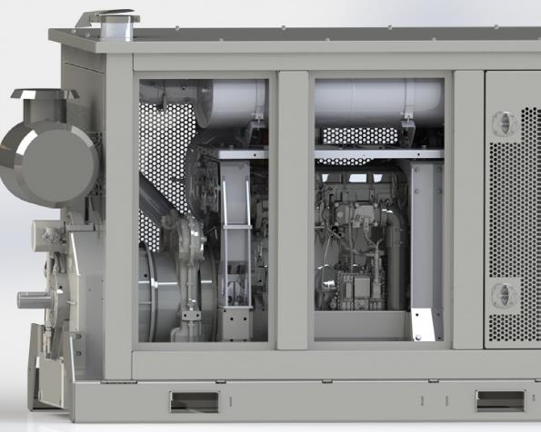
Engineering and Product Design
The customer and our engineering team work together to design the components. Once the design is approved by the customer, final pricing, build, and delivery times are determined.
A rendering of the solution developed and designed for this customer. A heavy-duty enclosure was later added to protect the drive system from extreme environmental conditions.

Slide 6
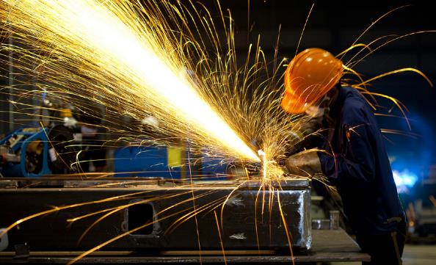
Manufacturing and Assembly
The customer and our engineering team work together to design the components. Once the design is approved by the customer, final pricing, build, and delivery times are determined. Final assembly of all systems is performed at Kraft Power’s Ohio location. All components are installed to manufacturer’s specifications.

Slide 7
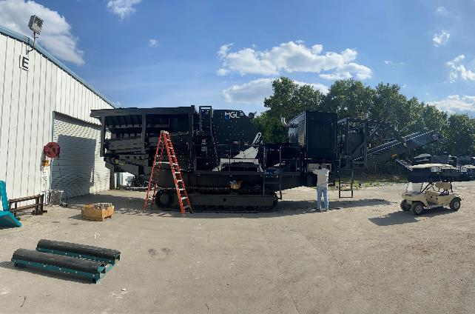
Delivery and Testing
The fully-assembled Kraft Power custom solution is shipped to the customer and then fitted onsite. Final adjustments are made, if needed. The completed product is now ready for Kraft Power and the customer to work together to perform in-field testing.
The completed enclosed power unit has been delivered to the customer’s facility and fitted onto their rock crusher. Engine and aftertreatment testing was successfully performed to ensure normal operation.

Slide 8
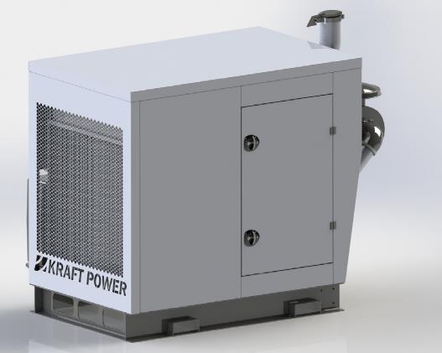
Looking Ahead
The custom-engineered unit has been assembled, and the prototype produced has been approved by the customer for use. It is now ready for mass production to accommodate future projects. By choosing to work with Kraft Power, the customer was able to receive a complete power solution from a single vendor, saving time, reducing administrative and financial costs, and ensuring their business operations were not disrupted.
Pictured is this customer’s fully enclosed FPT 515 HP diesel Tier 4 Final engine fitted with Transfluid’s MPD18 multiple pump drive, and KPTO21 fluid filled coupling.

Slide 9
Questions?

